Slide 1


Collaborative RDF Turtle Generator
Masters in Computer Science Cyber-Physical and Social Systems
Project in Virtual Communities
January-March 2022
Project Group Members:
Arun Raveendran Nair Sheela Sivaratnam PACHAVA Sushanta SAHA
Nuren SAMIA

Slide 2
Objective
The Main objective of this project is to convert the given set of the triples in to RDF Knowledge Graphs which includes the collaborative features like Comments, Discussion, Approve/Disapprove, Invitation

Slide 3
Scope of this Project
Only Authorized User allowed to access the software
User can able to create multiple datasets and in each datasets there should be able to create multiple triples.
Only approved triple are converted to RDF Knowledge Graph
Edit and delete the created Triples
User can able to invite new users or make discussions with the registered user through the platform

Slide 4
Actors and their Functions
Registered Users
Can login to the software
Create Datasets
Create Triple
Approve/Disapprove Triples
Give Votes to Triples
Invite new User
Generate RDF Graphs
Download RDF Graphs
Edit/Delete Turtles

Slide 5
Functional Requirement
Software allows the users to create a new account.
Require authentication of the users to allow them to use the system.
The software allows the registered users to add multiple datasets and see the existing datasets.
It allows users to add new triple to the dataset.
Users can able to edit triple, delete triple, comment to triple and vote the triple in the dataset.
It generates multiple RDF graphs to multiple datasets.
If suppose one user add any triple in the dataset, anyone of the other users can check and approve/disapprove it for the generation of the RDF graphs.
Upload triples from external sources.
Download the generated RDF graph.
Need conduct discussions about knowledge graph generation with help this software.
Registered users can able invite the new user to the system.

Slide 6
Non Functional Requirements
1. Performance
2. Usability
3.Responsive

Slide 7
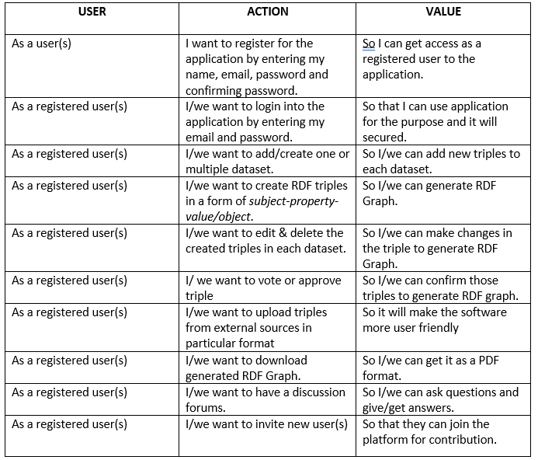
User Stories

Slide 8
Tools Used For this Project
Node.js , Express.js - Backend Development
Visual Studio Code - Editor
MongoDB and MongoDB Compass - Database
Hppscotch.io – online API Testing Tools
Vue.js, Wave UI - Front-End Development

Slide 9
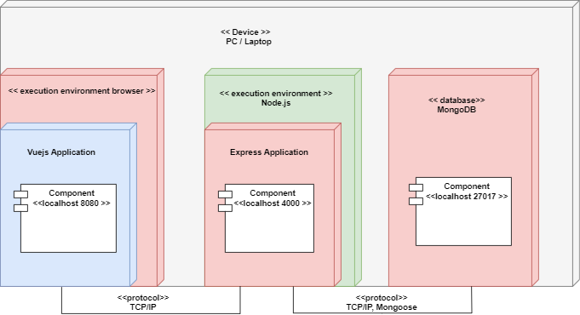
Deployment Diagram

Slide 10
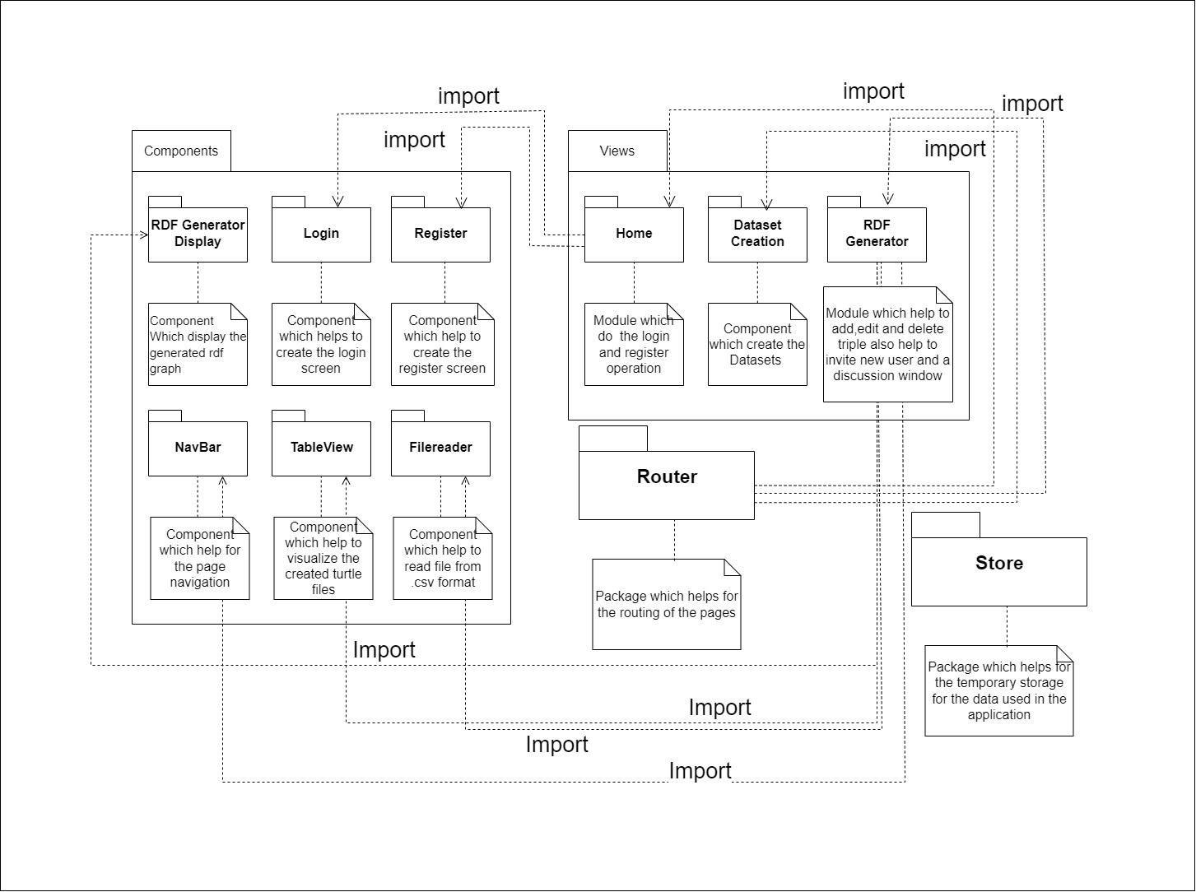
Package Diagram For the Server

Slide 11
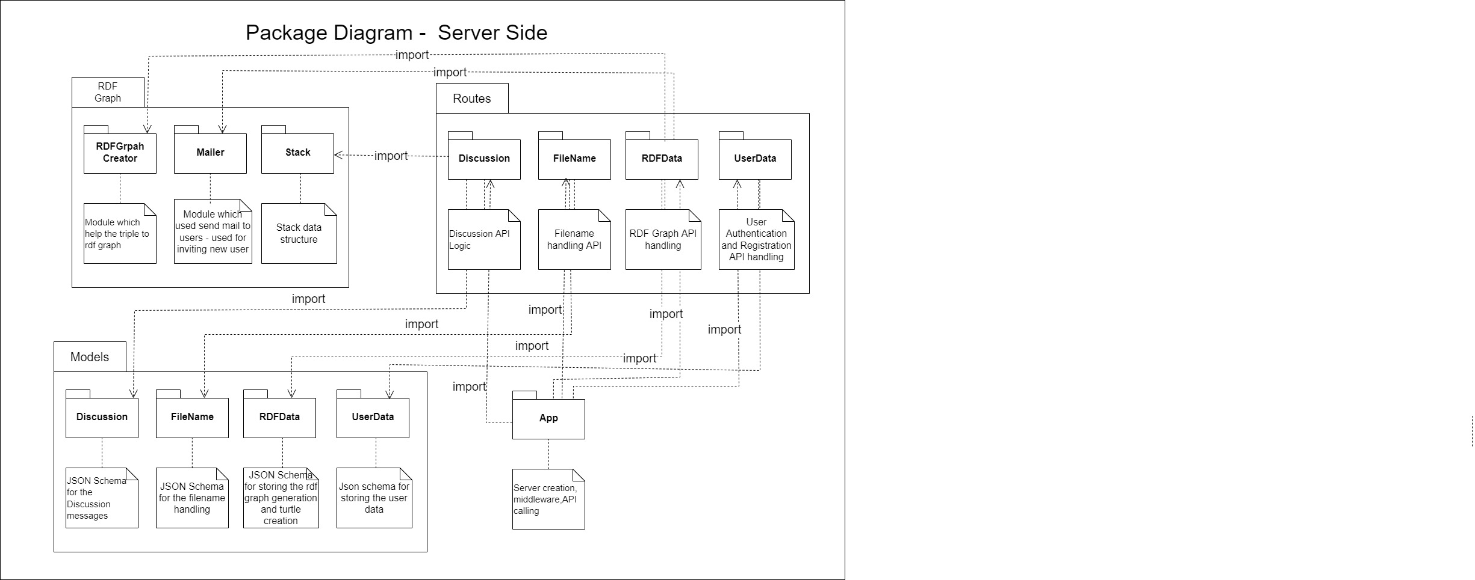
Package Diagram For the Client

Slide 12
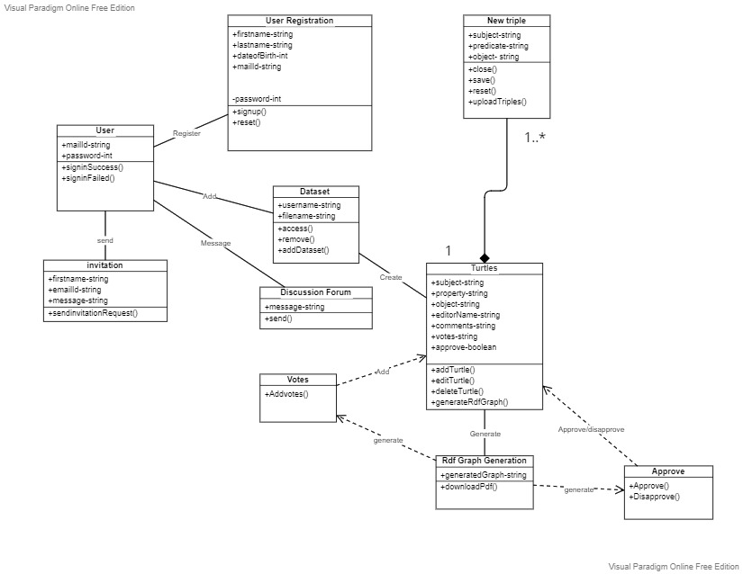
Class Diagram

Slide 13
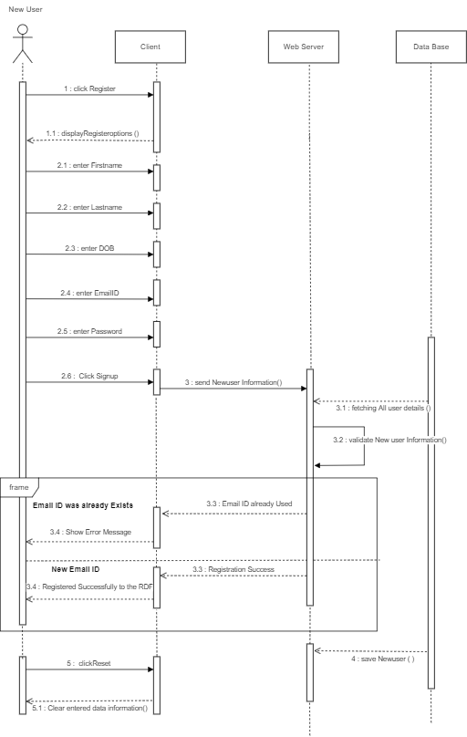
Sequence Diagram - Registration for new user

Slide 14
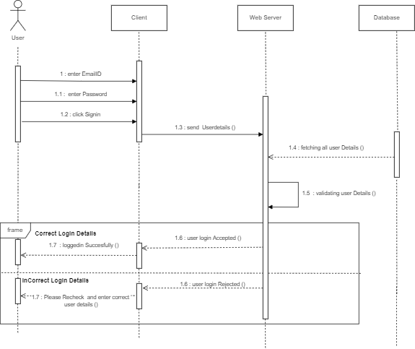
Sequence Diagram –Login to the system

Slide 15
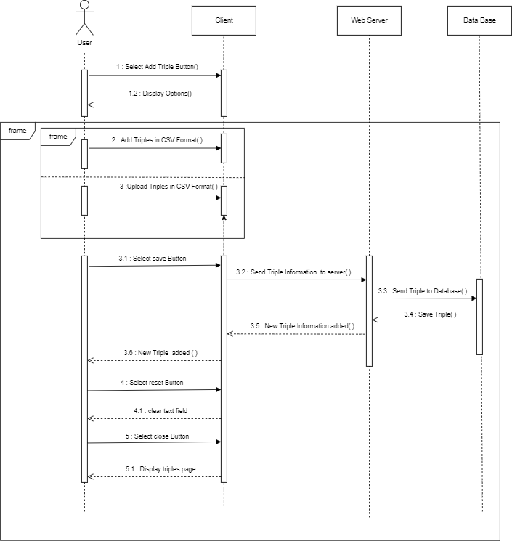
Sequence Diagram - Create RDF Triple

Slide 16
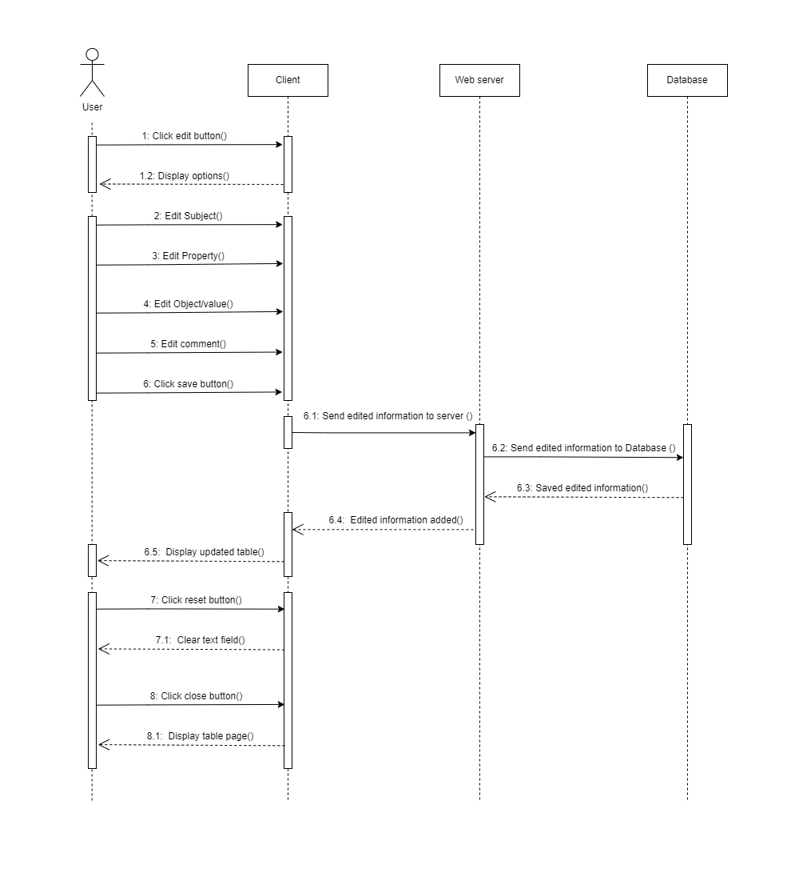
Sequence Diagram - Edit RDF Triple

Slide 17
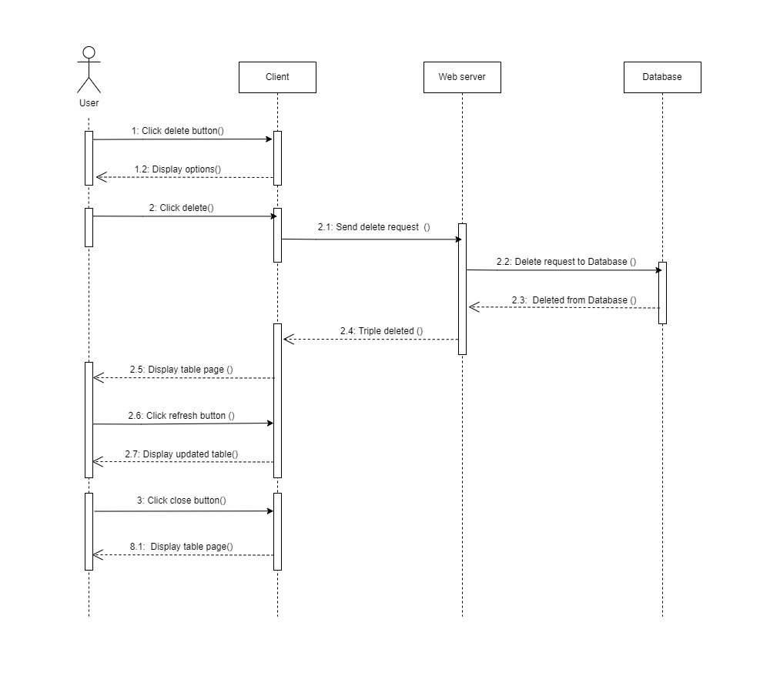
Sequence Diagram - Delete RDF Triple

Slide 18
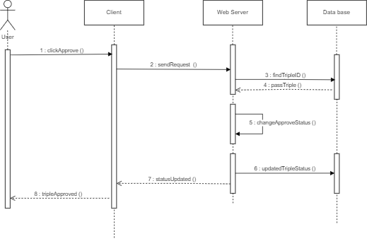
Sequence Diagram - Approve RDF Triple

Slide 19
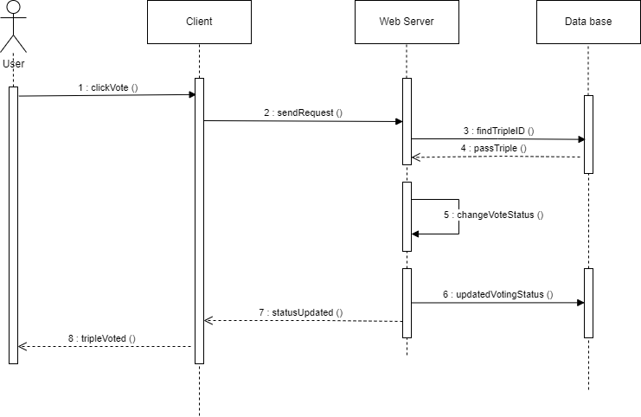
Sequence Diagram - Vote RDF Triple

Slide 20
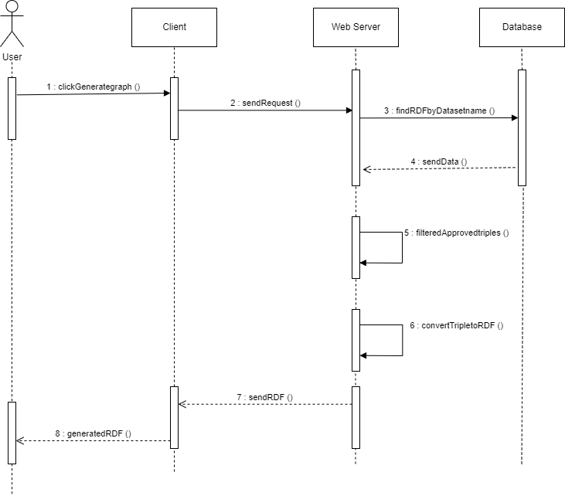
Sequence Diagram - Generate RDF Graph

Slide 21
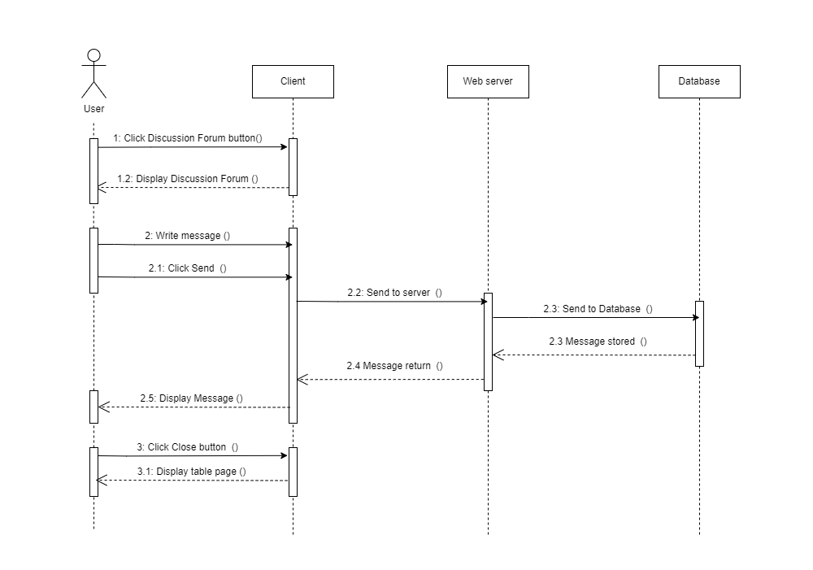
Sequence Diagram - Discussion (Asking Questions)

Slide 22
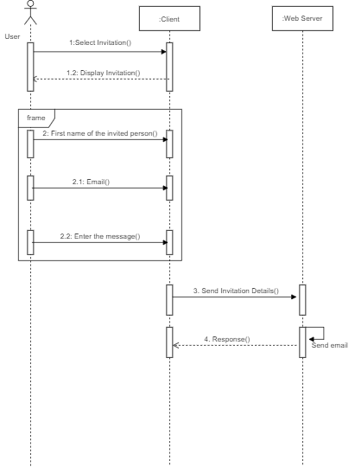
Sequence Diagram - Invite New User

Slide 23
Project Demonstration

Slide 24
Thank You For Hearing Us!

